Slide 1



WEBINAR PRESENTATION
JUNE 11, 2020, 02:00 PM – 04:00 PM
Organized By
Department of Electrical and Electronics Engineering
RGM COLLEGE OF ENGINEERING AND TECHNOLOGY, NANDYAL
In Association With
SIMULATION OF POWER CONVERTERS USING PYTHON
Dr. M.Kaliamoorthy
Associate Professor
Department of Electrical and Electronics Engineering
Dr.Mahalingam College of Engineering and Technology
Pollachi Tamilnadu-642003
Tel: 9865065166 kaliasgoldmedal@gmail.com www.kaliasgoldmedal.com
The Journey of Thousand Miles Begins with a single step

Slide 2
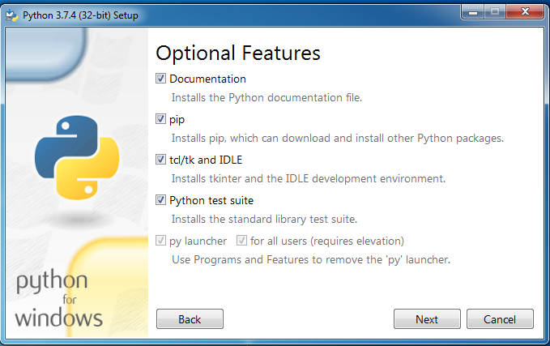
INSTALL PYTHON
https://www.anaconda.com/products/individual#windows

Slide 3
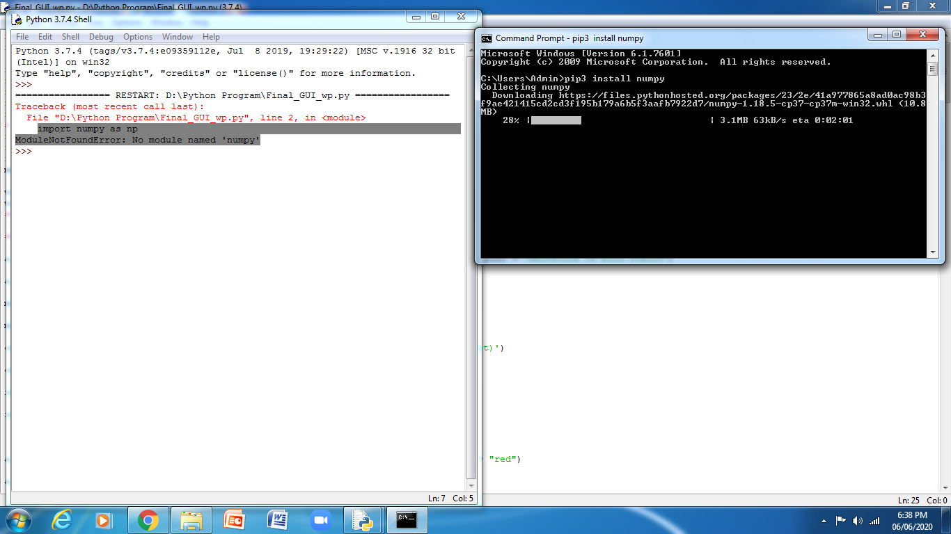
INSTALL numpy Package
PIP3 install numpy

Slide 4
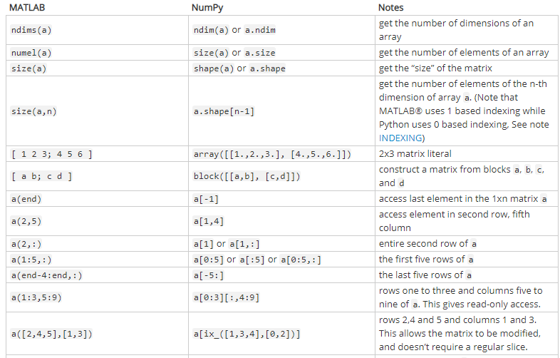

Slide 5
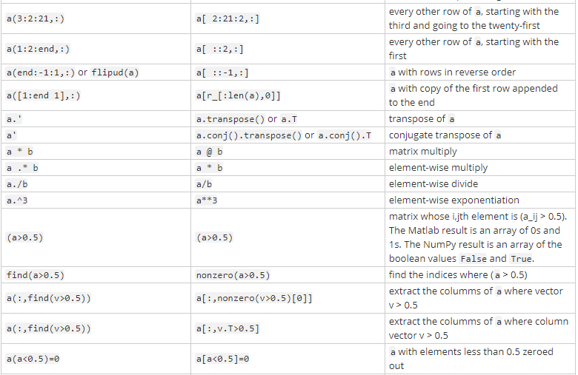

Slide 6
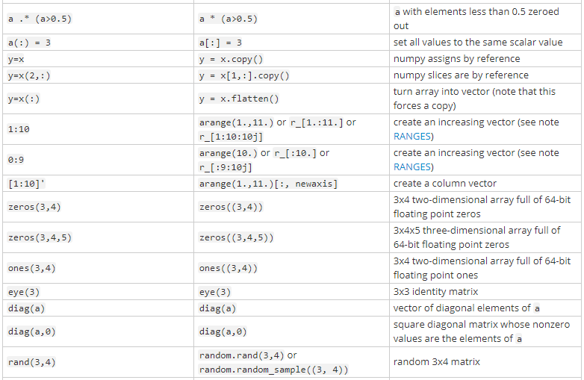

Slide 7
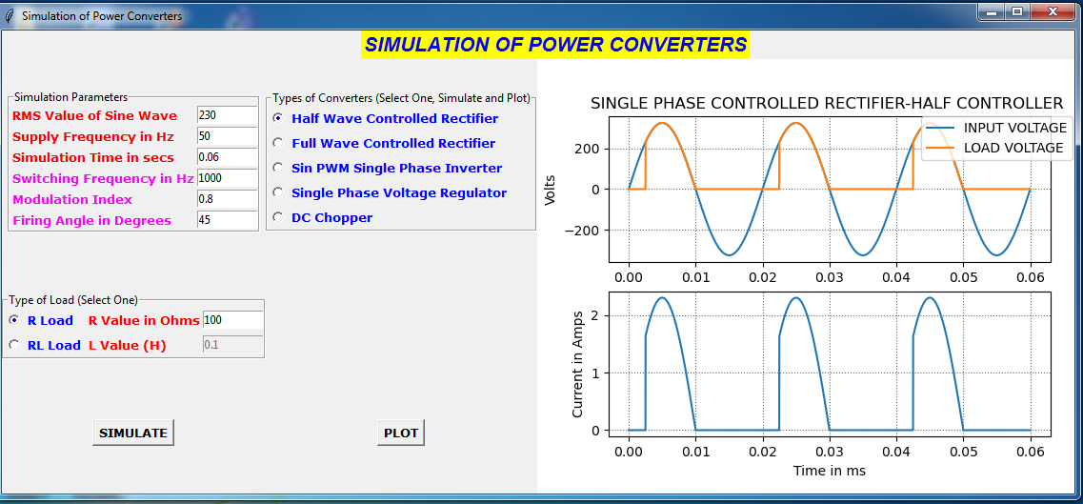
Importing Packages
import numpy as np
import tkinter as tk
import math
from pylab import *
from scipy.optimize import *
from matplotlib import *

Slide 8
Initializing Window
import numpy as np
import tkinter as tk
import math
from pylab import *
from scipy.optimize import *
from matplotlib import *
win =tk.Tk()
win.title("Simulation of Power Converters")

Slide 9
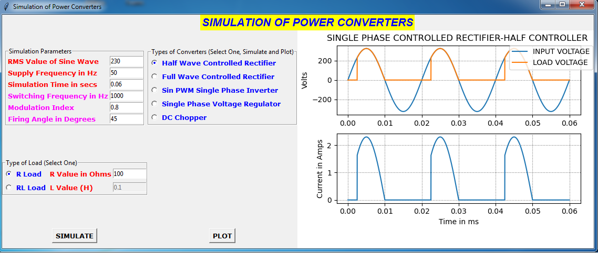
a_title= tk.Label(win,text="SIMULATION OF POWER CONVERTERS", fg = "blue",bg = "yellow",font
a_title.grid(column=0, row=0, columnspan=3) = "Helvetica 16 bold italic")
Column 0
Column 1
Column 2
Row 0
Row 1
Row 2
Row 3

Slide 10
mighty = tk.LabelFrame(win, text='Simulation Parameters‘)
mighty.grid(column=0, row=1)
Column 0
Column 1
Column 2
Row 0
Row 1
Row 2
Row 3

Slide 11
contypes = tk.LabelFrame(win, text='Types of Converters (Select One, Simulate and Plot)
contypes.grid(column=1, row=1)
Column 0
Column 1
Column 2
Row 0
Row 1
Row 2
Row 3

Slide 12
res = tk.LabelFrame(win, text='Plot Area‘)
res.grid(column=2, row=1, rowspan=3)
Column 0
Column 1
Column 2
Row 0
Row 1
Row 2
Row 3

Slide 13
btn = tk.Button(win, text="SIMULATE", command=simulate, font = "Verdana 10 bold“)
btn.grid(column=0, row=3)
Column 0
Column 1
Column 2
Row 0
Row 1
Row 2
Row 3

Slide 14
btn1 = tk.Button(win, text="PLOT", command=plt1,font = "Verdana 10 bold“)
btn1.grid(column=1, row=3)
Column 0
Column 1
Column 2
Row 0
Row 1
Row 2
Row 3

Slide 15
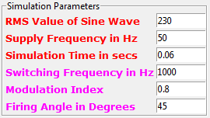
a_input = tk.Label(mighty, text="RMS Value of Sine Wave",font = "Verdana 10 bold",fg = "red“)
a_input.grid(column=0, row=0, sticky=tk.W)
C0
C1
peamp = tk.Entry(mighty,width=10)
peamp.insert(0,"230“)
peamp.grid(column=1, row=0)
R0
R1
R2
R3
R4
R5
a_supply = tk.Label(mighty, text="Supply Frequency in Hz",font = "Verdana 10 bold",fg = "red",justify=tk.LEFT)
a_supply.grid(column=0, row=1, sticky=tk.W)
freq = tk.Entry(mighty,width=10)
freq.insert(0,"50")
freq.grid(column=1, row=1)

Slide 16
a_time = tk.Label(mighty, text="Simulation Time in secs",font = "Verdana 10 bold",fg = "red“)
a_time.grid(column=0, row=2, sticky=tk.W)
simtime = tk.Entry(mighty,width=10)
simtime.insert(0,"0.06“)
simtime.grid(column=1, row=2)
C0
C1
R0
R1
R2
R3
R4
R5
a_freq = tk.Label(mighty, text="Switching Frequency in Hz",font = "Verdana 10 bold",fg = "magenta“)
a_freq .grid(column=0, row=3, sticky=tk.W)
sf = tk.Entry(mighty,width=10)
sf.insert(0,"1000“)
sf.grid(column=1, row=3)

Slide 17
a_mi = tk.Label(mighty, text="Modulation Index",font = "Verdana 10 bold",fg = "magenta",justify=tk.LEFT)
a_mi.grid(column=0, row=4, sticky=tk.W)
m = tk.Entry(mighty,width=10)
m.insert(0,"0.8")
m.grid(column=1, row=4)
C0
C1
R0
R1
R2
R3
R4
R5
a_fire = tk.Label(mighty, text="Firing Angle in Degrees",font = "Verdana 10 bold",fg = "magenta“)
a_fire.grid(column=0, row=5, sticky=tk.W)
alpha = tk.Entry(mighty,width=10)
alpha.insert(0,"45“)
alpha.grid(column=1, row=5)

Slide 18
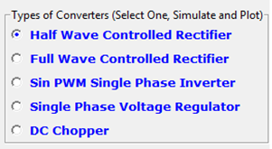
selected = tk.IntVar()
rad1 = tk.Radiobutton(contypes,text='Half Wave Controlled Rectifier', value=1, variable=selected,
font = "Verdana 10 bold",fg = "blue",)
rad2 = tk.Radiobutton(contypes,text='Full Wave Controlled Rectifier', value=2, variable=selected,
font = "Verdana 10 bold",fg = "blue“)
rad3 = tk.Radiobutton(contypes,text='Sin PWM Single Phase Inverter', value=3, variable=selected,
font = "Verdana 10 bold",fg = "blue“)
rad4 = tk.Radiobutton(contypes,text='Single Phase Voltage Regulator', value=4, variable=selected,
font = "Verdana 10 bold",fg = "blue“)
rad5 = tk.Radiobutton(contypes,text='DC Chopper', value=5, variable=selected, font = "Verdana 10 bold",
fg = "blue")
rad1.grid(column=0, row=1, sticky=tk.W)
rad2.grid(column=0, row=2, sticky=tk.W)
rad3.grid(column=0, row=3, sticky=tk.W)
rad4.grid(column=0, row=4, sticky=tk.W)
rad5.grid(column=0, row=5, sticky=tk.W)
selected.set(1)

Slide 19

loadchoice = tk.IntVar()
load1 = tk.Radiobutton(loadtype,text='R Load', value=1, variable=loadchoice,font = "Verdana 10 bold",fg = "blue",
command=sel)
load2 = tk.Radiobutton(loadtype,text='RL Load', value=2, variable=loadchoice,font = "Verdana 10 bold",fg = "blue",
command=sel)
load1.grid(column=0, row=1, sticky=tk.W)
load2.grid(column=0, row=2, sticky=tk.W)
loadchoice.set(2)
r_input = tk.Label(loadtype, text="R Value in Ohms",font = "Verdana 10 bold",fg = "red“)
r_input.grid(column=1, row=1, sticky=tk.W)
rvalue = tk.Entry(loadtype,width=10)
rvalue.insert(0,"100“)
rvalue.grid(column=3, row=1)
l_input = tk.Label(loadtype, text="L Value (H) ",font = "Verdana 10 bold",fg = "red")
l_input.grid(column=1, row=2, sticky=tk.W)
lvalue = tk.Entry(loadtype,width=10)
lvalue.insert(0,"0.1“)
lvalue.grid(column=3, row=2)

Slide 20

def sel():
global l
l = int(loadchoice.get())
if l==1:
lvalue.config(state='disabled')
else:
lvalue.config(state='normal')

Slide 21
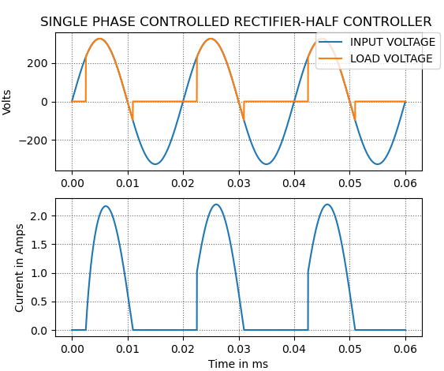
  fig = Figure(figsize=(6, 5), dpi=100)
a1 = fig.add_subplot(211)
a1.plot(time, amplitude2,label="INPUT VOLTAGE")
a1.plot(time , amplitude3, label="LOAD VOLTAGE")
a1.set_title('SINGLE PHASE CONTROLLED RECTIFIER-HALF CONTROLLER ')
a1.set_ylabel('Volts')
a1.legend(bbox_to_anchor=(1.05, 1), loc='upper right', borderaxespad=0.)
a1.grid(b=True, which='major', color='#666666', linestyle=':')
a3 = fig.add_subplot(212)
a3.plot(time, lcurrent,label="Load Current")
a3.set_xlabel('Time in ms')
a3.set_ylabel('Current in Amps')
a3.grid(b=True, which='major', color='#666666', linestyle=':')

Slide 22
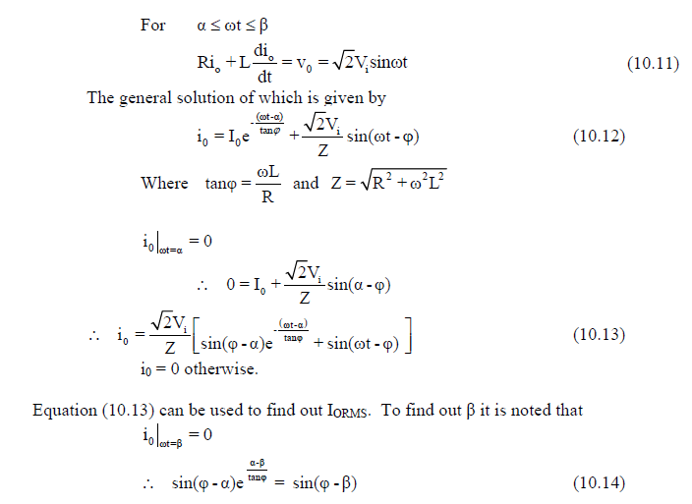
def func(b):
k = int(loadchoice.get())
a1=math.radians(int(alpha.get()))
fr=int(freq.get())
L1=float(lvalue.get())
R1=float(rvalue.get())
if k==1:
langle = (math.atan(2*math.pi*fr*0/R1))
else:
langle = (math.atan(2*math.pi*fr*L1/R1))
r1=(a1-b)/math.tan(langle)
return math.sin(langle-b)-(math.sin(langle-a1)*math.exp(r1))
beta = (fsolve(func, 3.14))

Slide 23

def simulate():
global s, l, time, amplitude1, amplitude2, amplitude3, amplitude4, amplitude5, lcurrent
s= int(selected.get()) beta = (fsolve(func, 3.14))
l = int(loadchoice.get()) print(beta)
tt = float(simtime.get()) time = np.arange(0, tt, 0.00001);
if s==1: P=2/f1
V= float(peamp.get()) amplitude1=(360*(P-abs((time*2%P)-P)))/P
f1=int(freq.get())
a=int(alpha.get())
L=float(lvalue.get())
R=float(rvalue.get())
if l==1:
langle = (math.atan(2*math.pi*f1*0/R))
L=0
else:
langle = (math.atan(2*math.pi*f1*L/R))

Slide 24

amplitude2= V*math.sqrt(2)*(np.sin(2*math.pi*f1*time))
Z = math.sqrt((R*R)+(2*math.pi*f1*2*math.pi*f1*L*L))
ad = math.radians(a)
x1 = sin((2*math.pi*f1*time)-langle)
x2 = math.sin(langle-ad)
e1 = -((2*math.pi*f1*time)-ad)/math.tan(langle)
x3 = np.exp(e1)
lcurrent = (V/Z)*((x2*x3)+x1)
g=len(time)
amplitude3=V*sqrt(2)*(np.sin(2*math.pi*f1*time))

