Slide 1


FUNDAMENTALS OF ELECTRO MAGNETICS
PRESENTATION
SEP 7 2015, 10:00 AM – 12:00 Noon
at
SNS College of Engineering
Coimbatore
Dr. M.Kaliamoorthy,
Professor
Department of Electrical and Electronics Engineering
Karpagam College of Engineering
Coimbatore
Tel: 9865065166
E-Mail: kaliasgoldmedal@gmail.com,
kaliasgoldmedal@ieee.com
Website: www.kaliasgoldmedal.yolasite.com
The Journey of Thousand Miles Begins with a single step

Slide 2
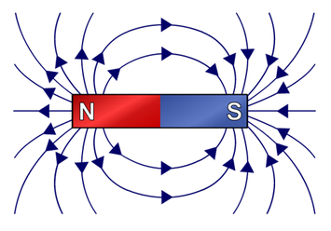
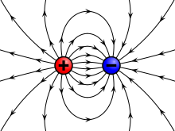
FUNDAMENTALS OF ELECTRO MAGNETICS
What is Electromagnetics ?
The study and application of electric and magnetic fields
What is Field ?
In physics, a field is a physical quantity that has a value for each point in space and time

Slide 3
Scalars and Vectors
Scalar
Whose value may be represented by a single real number,
which may be Positive or Negative.
Direction is not required
Examples Temperature, Mass, Volume, Speed, Density etc
Vector
Has Magnitude and Specific direction in Space.
In Electromagnetics 2D & 3D space is required, but vectors may
be nD.
Examples Force, Displacement, Acceleration etc

Slide 4




Representation of a Vector
A (Ending Point)
R
Unit Vector
Magnitude is always unity
It is used to indicate direction of
any vector
O (Starting Point)
Unit Vector along the direction OA and

Slide 5

Vector Algebra
Scaling of a Vector
Multiplication of a Scalar to a Vector
Addition of Vectors
O
O

Slide 6

Vector Algebra
Subtraction of Vectors
O
Vector Multiplication
Scalar Product (or) Dot product
Vector Product (or) Cross product

Slide 7




Vector Algebra
Scalar (or) Dot Product of Vectors
-It is denoted by
-It is the product of magnitude of
& the product of
magnitude of
and the cosine angle between
&
-It is the product of magnitude of
& the projection of
on to
If
then
&
are parallel
O
If
then
&
are perpendicular

Slide 8
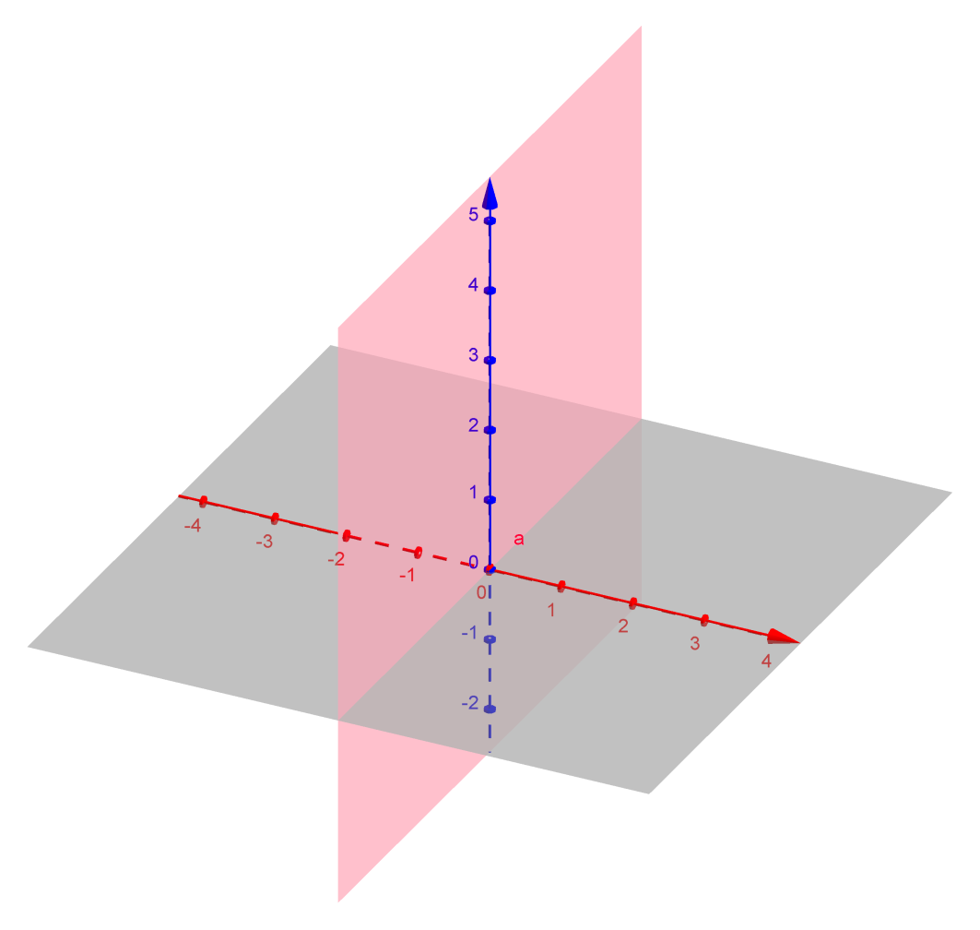
Cartesian Coordinate Systems
Y axis
5
(3,4)
4
3
(3,4)
2
1
1
2
3
4
5
X axis

Slide 9
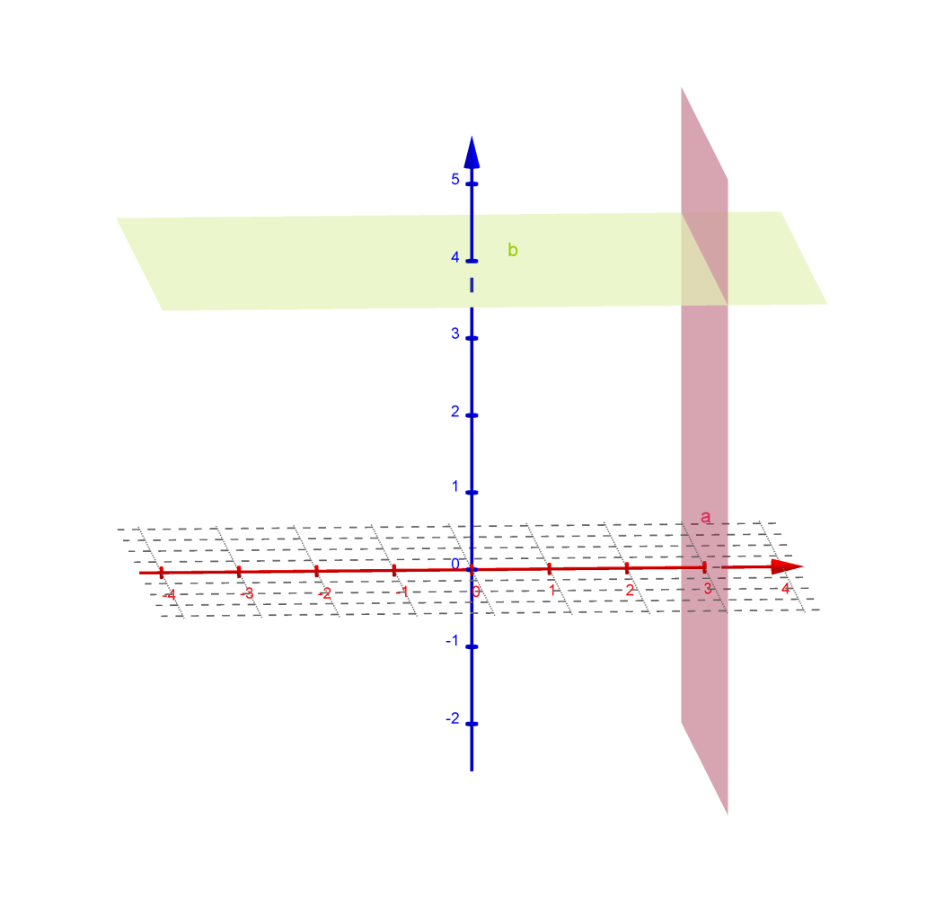
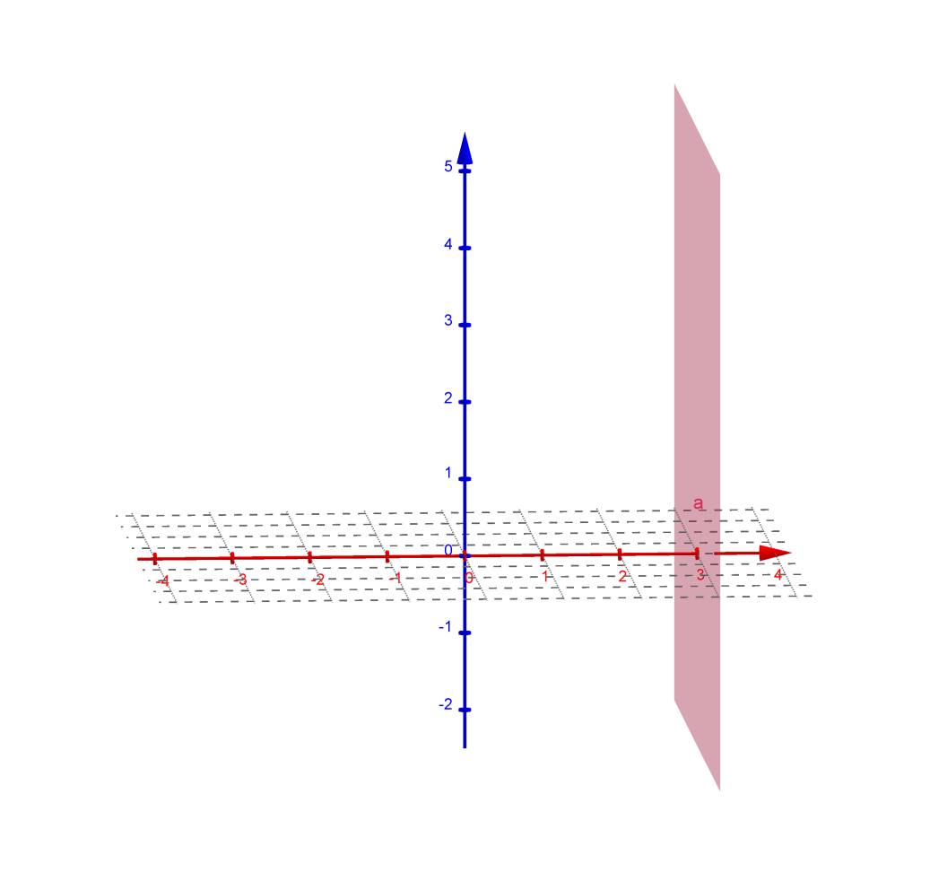
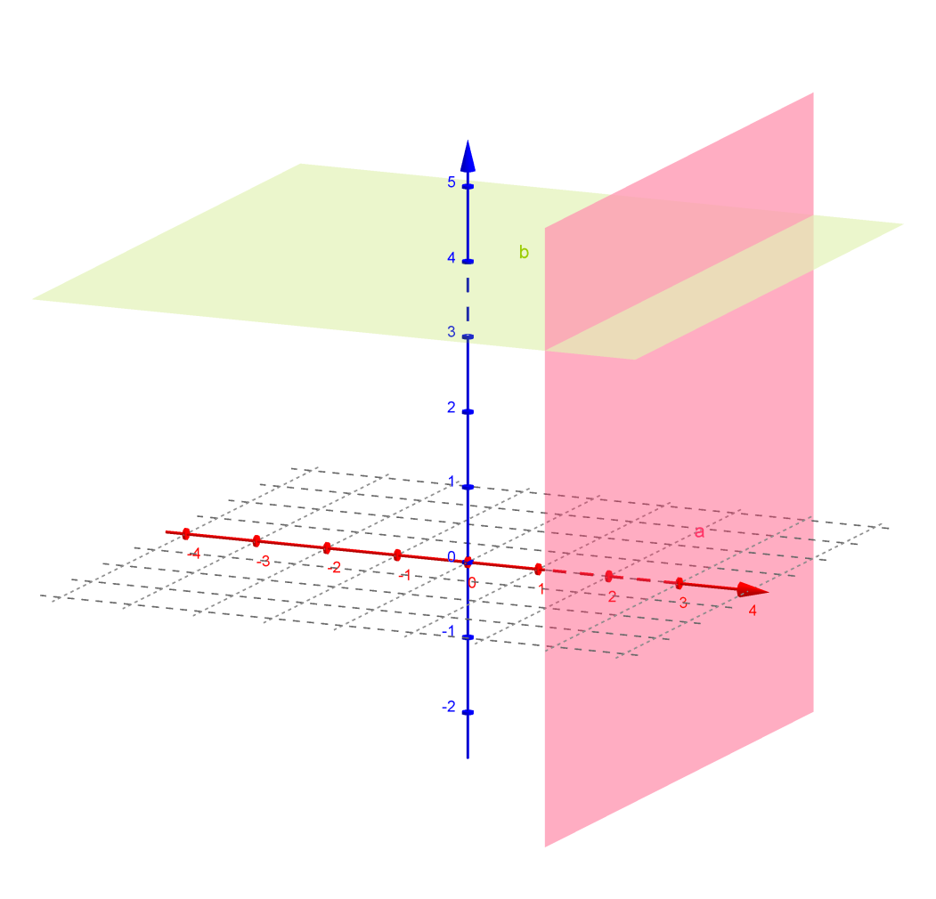
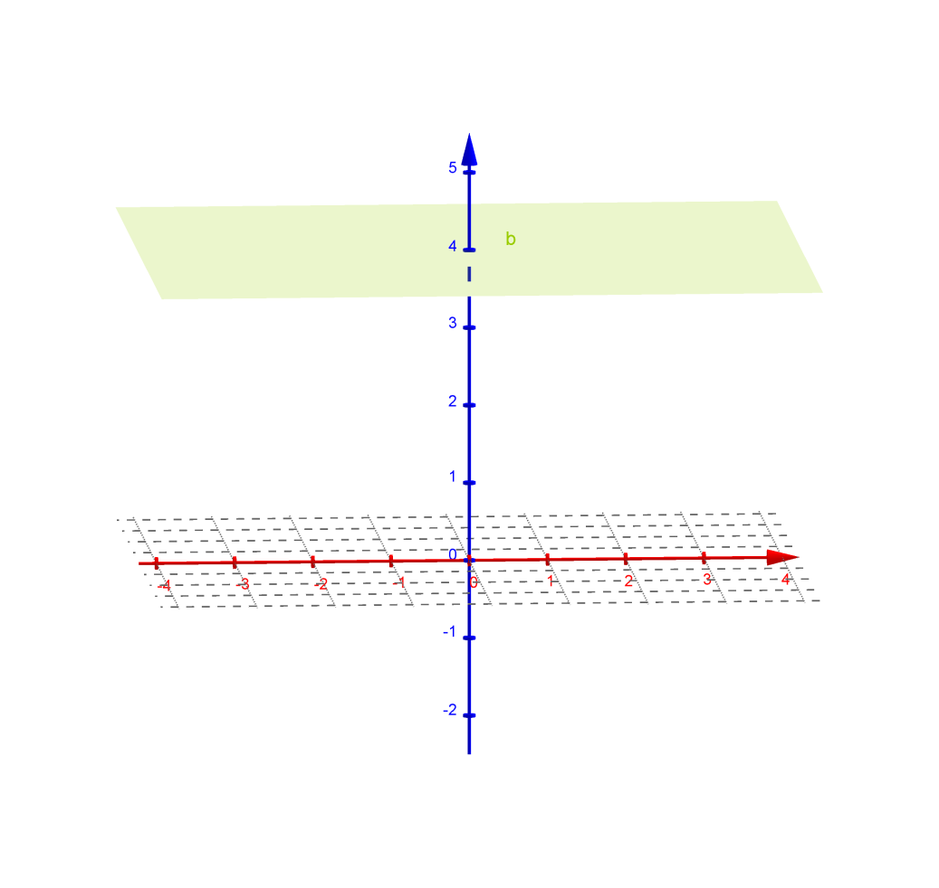
Cartesian Coordinate Systems

Slide 10
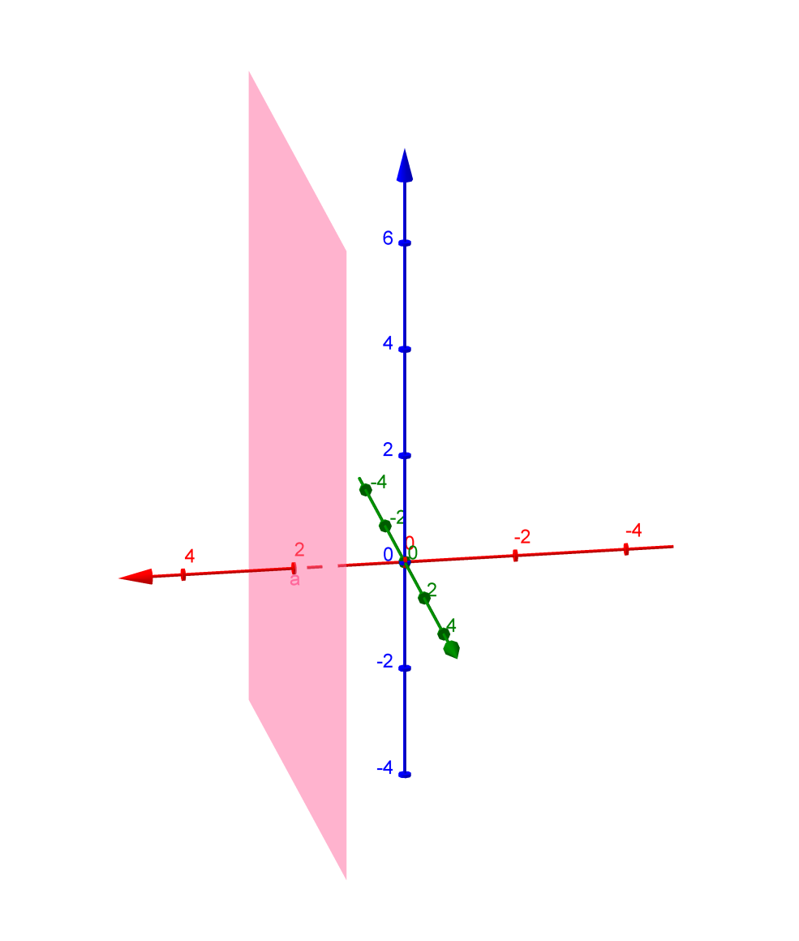
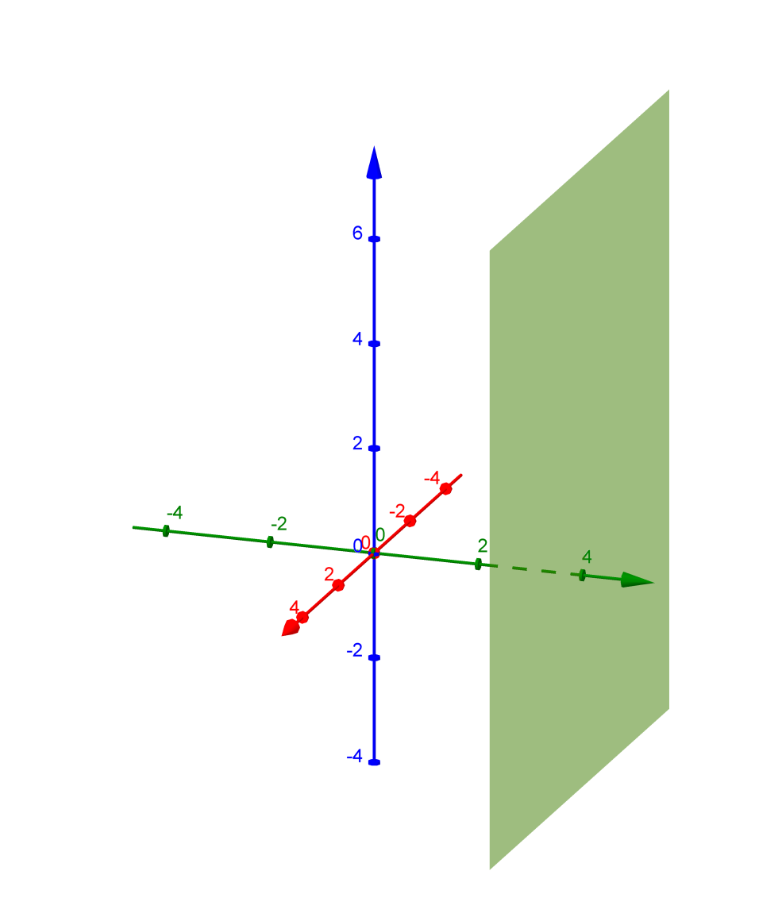
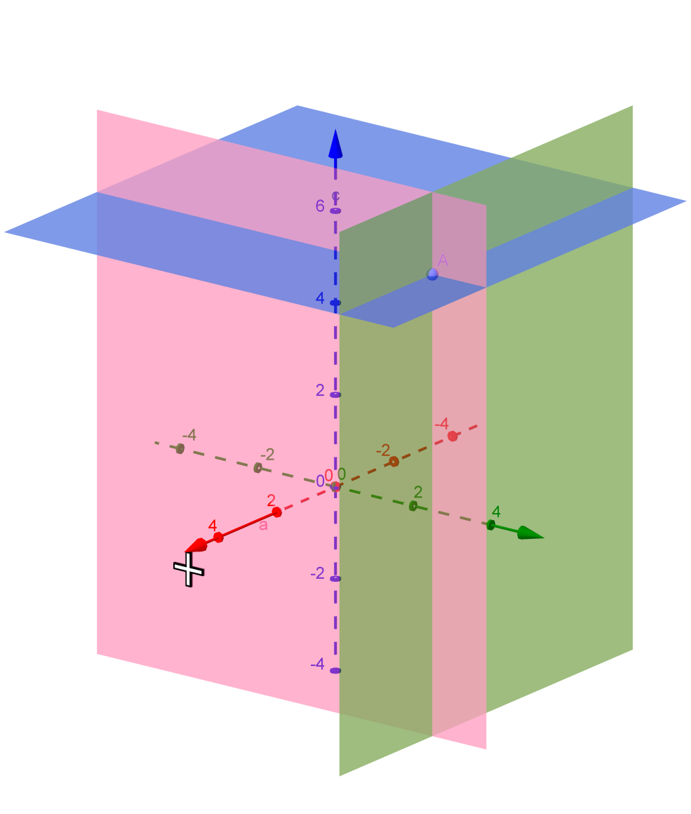
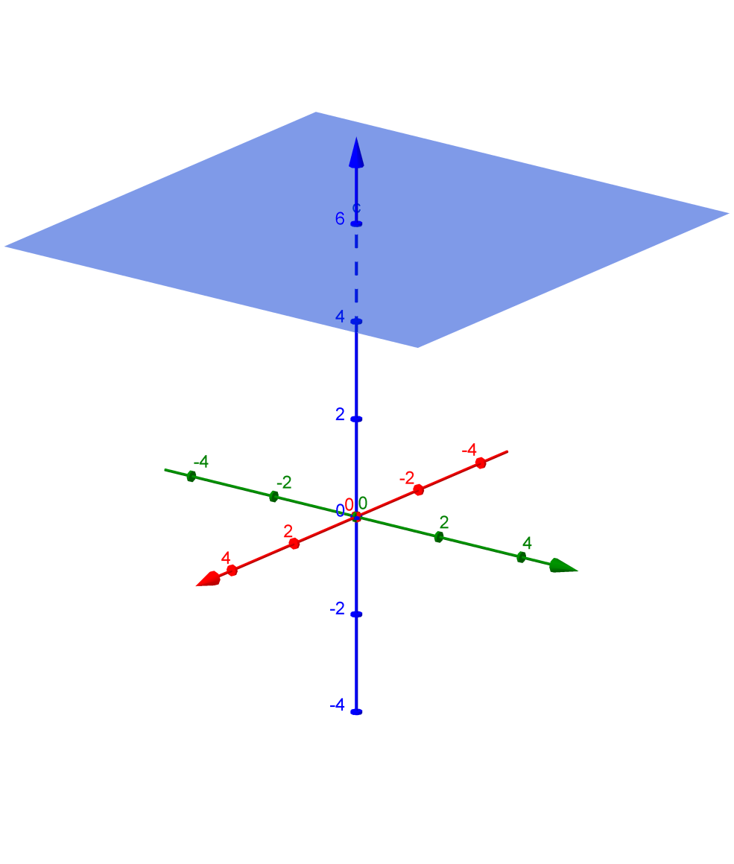

Cartesian Coordinate Systems
z
(2,4,6)
6
2
y
x
4

Slide 11
Differential Elements in Cartesian Coordinate Systems
z
x+dx, y+dy, z+dz
(x,y,z)
dz
dx
dy
y
x

Slide 12




Differential Elements in Cartesian Coordinate Systems
-Differential Surface Element
z
x+dx, y+dy, z+dz
Differential Surface area element (Magnitude)
(x,y,z)
dz
dz
dx
Unit vector normal to ds
dy
dy
y
x
dx
dx
dy

Slide 13
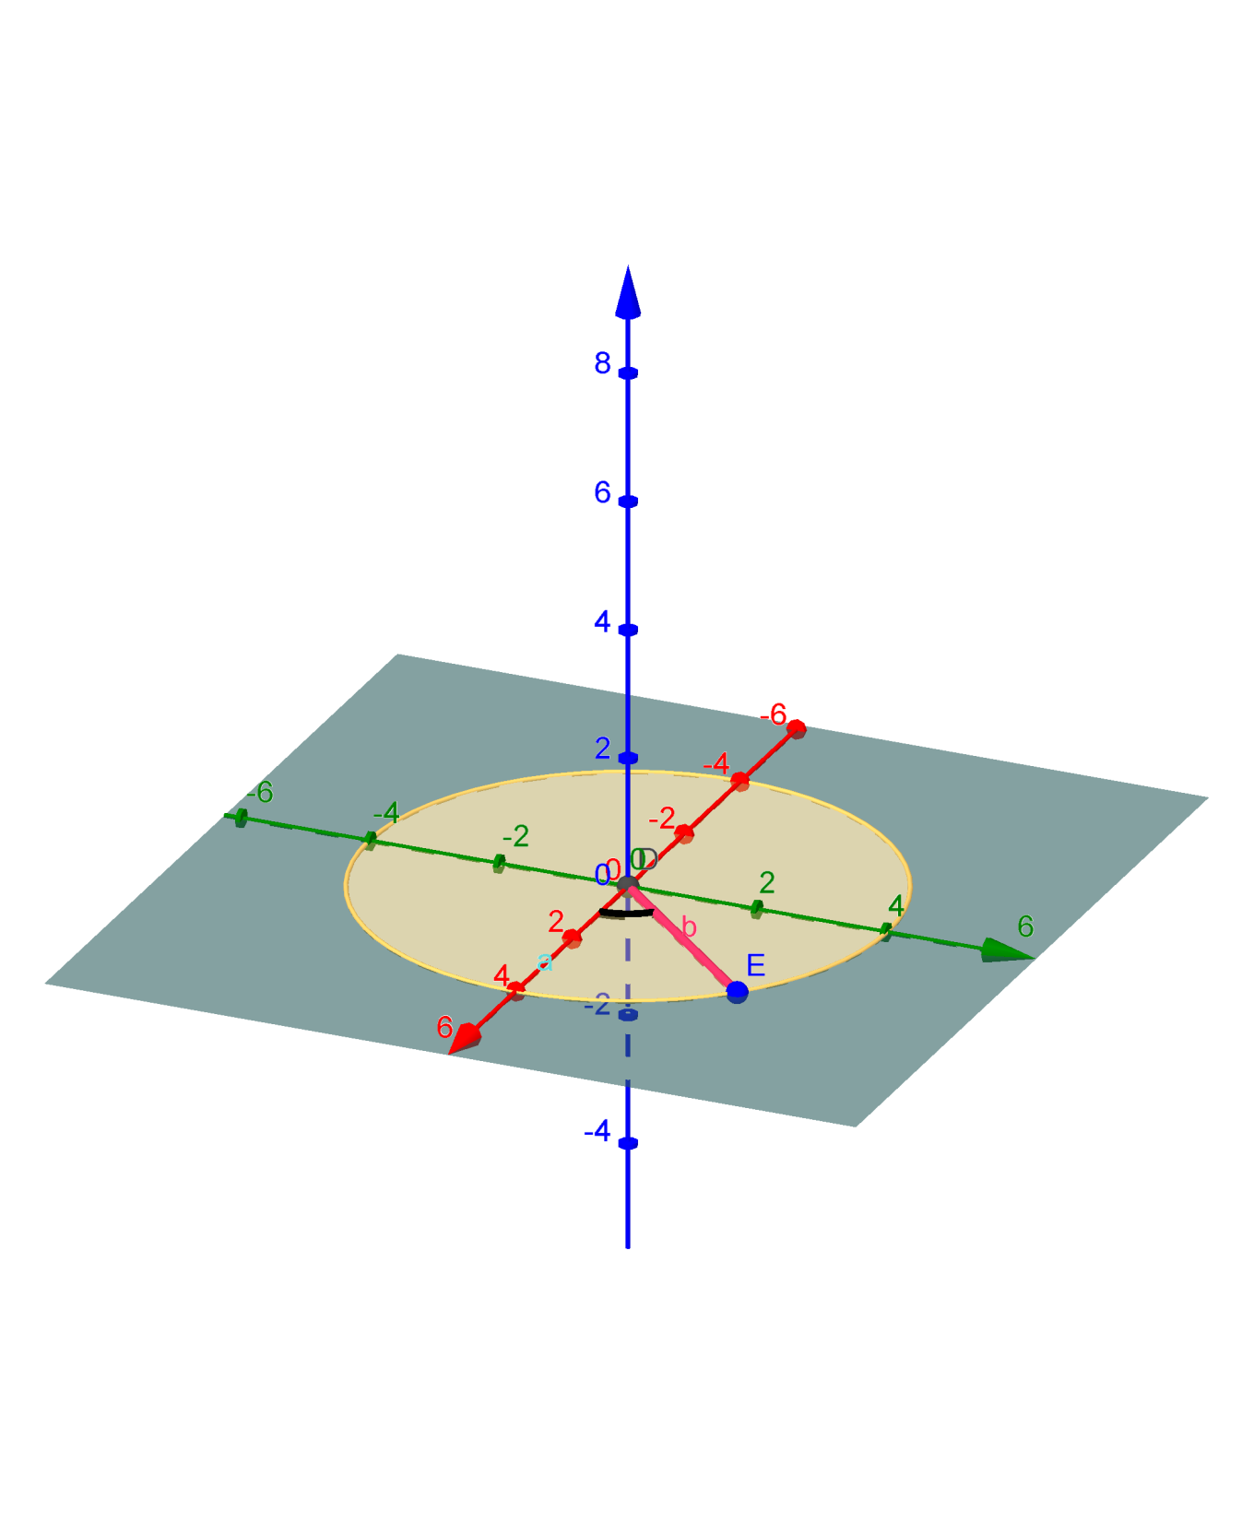
Cylindrical Coordinate Systems
90⁰
(r,θ)
r
θ
180⁰
0⁰
270⁰

Slide 14
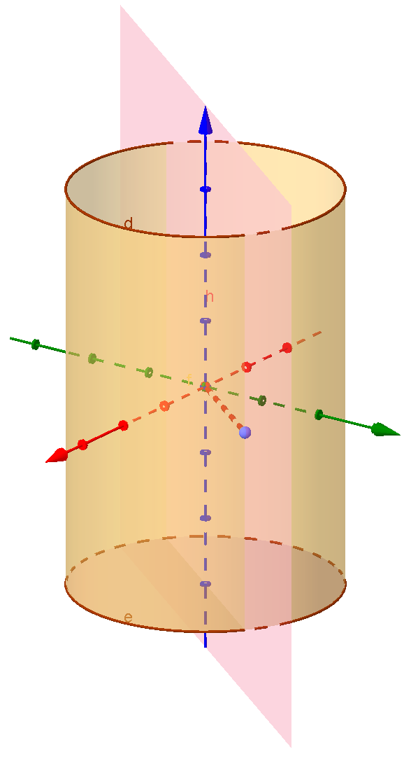
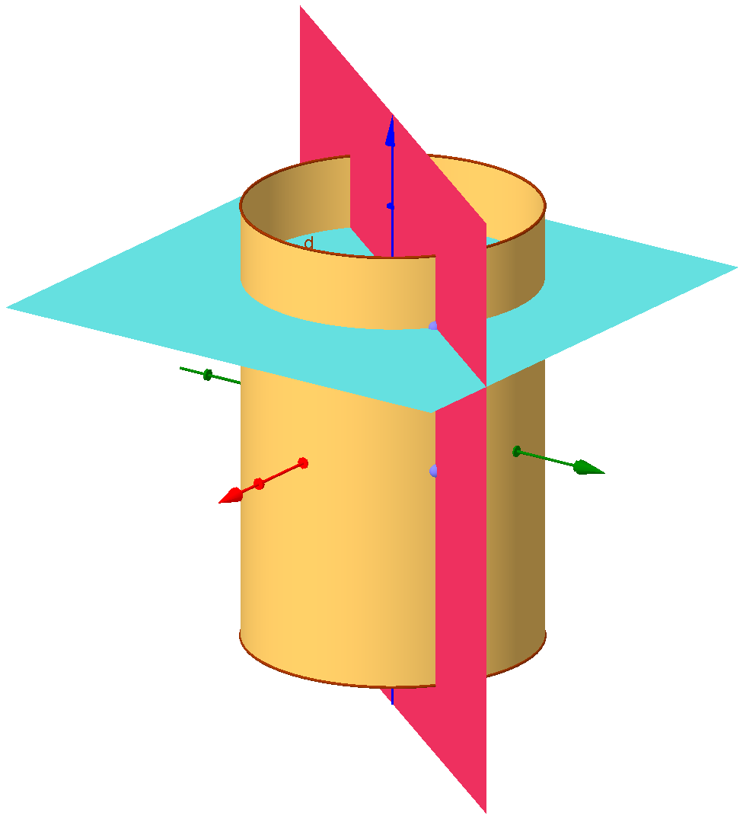
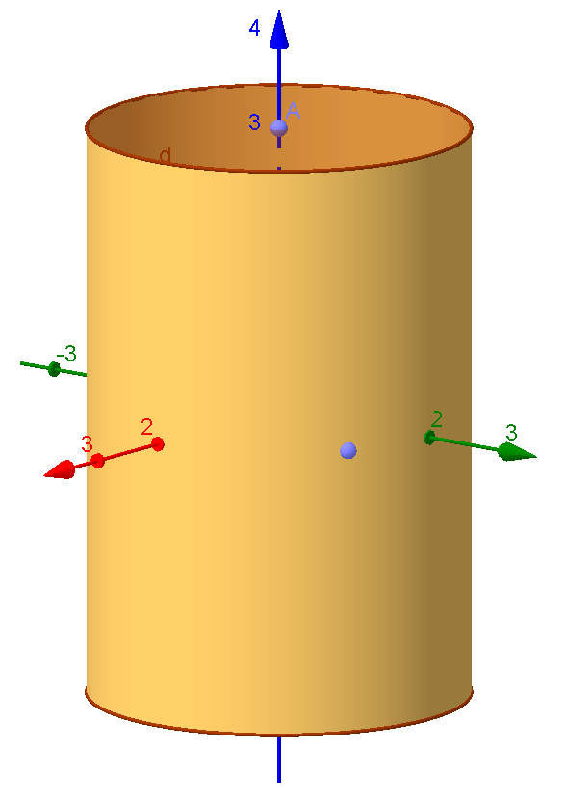
Cylindrical Coordinate Systems

Slide 15


Cylindrical Coordinate Systems
*
z
r
z
o
y
Ø
x

Slide 16




Differential Elements in Cylindrical Coordinate Systems
z
z + dz
dØ
z
dz
dz
dz
r
r dØ
r dØ
dr
o
dr
y
Ø
Ø + dØ
r + dr
r
x

Slide 17
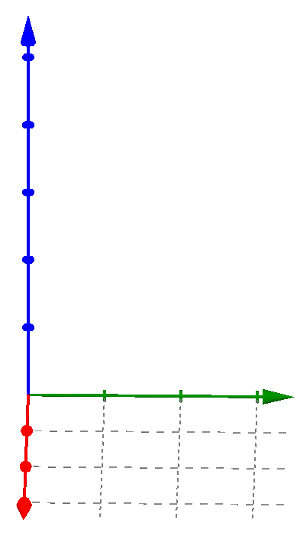







Relationship between Cartesian and Cylindrical Coordinate Systems
p(x, y, z) = p(r, Φ, z)
r
y
Φ
90⁰
x
x
Φ
r
y

Slide 18
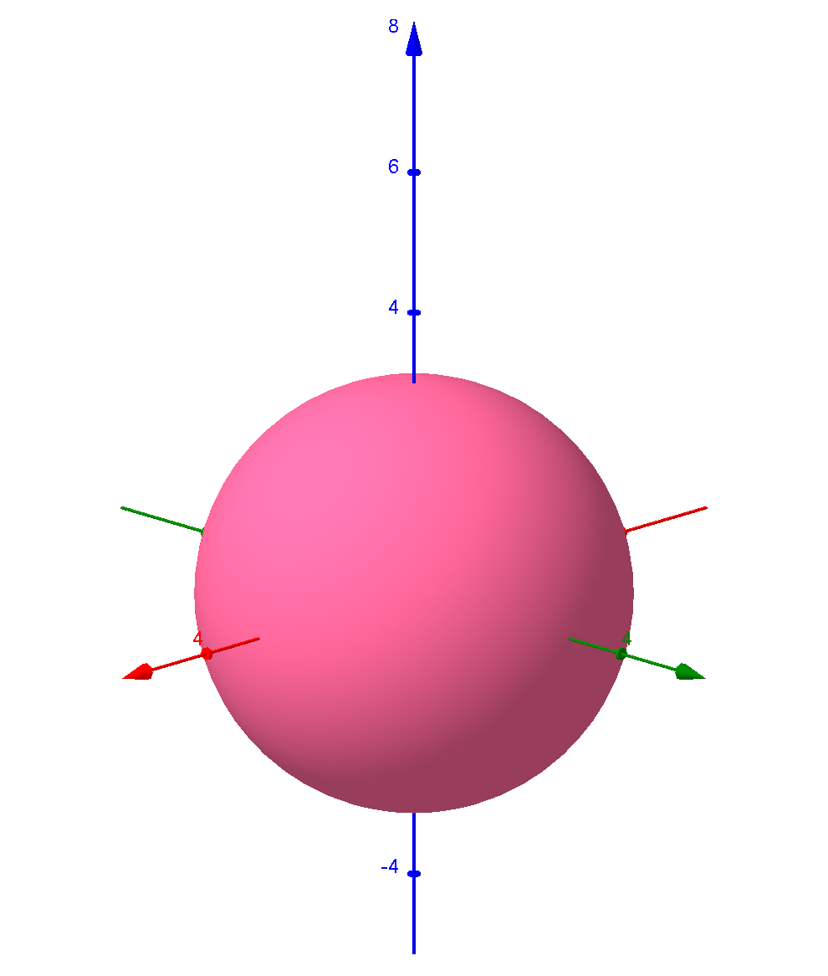
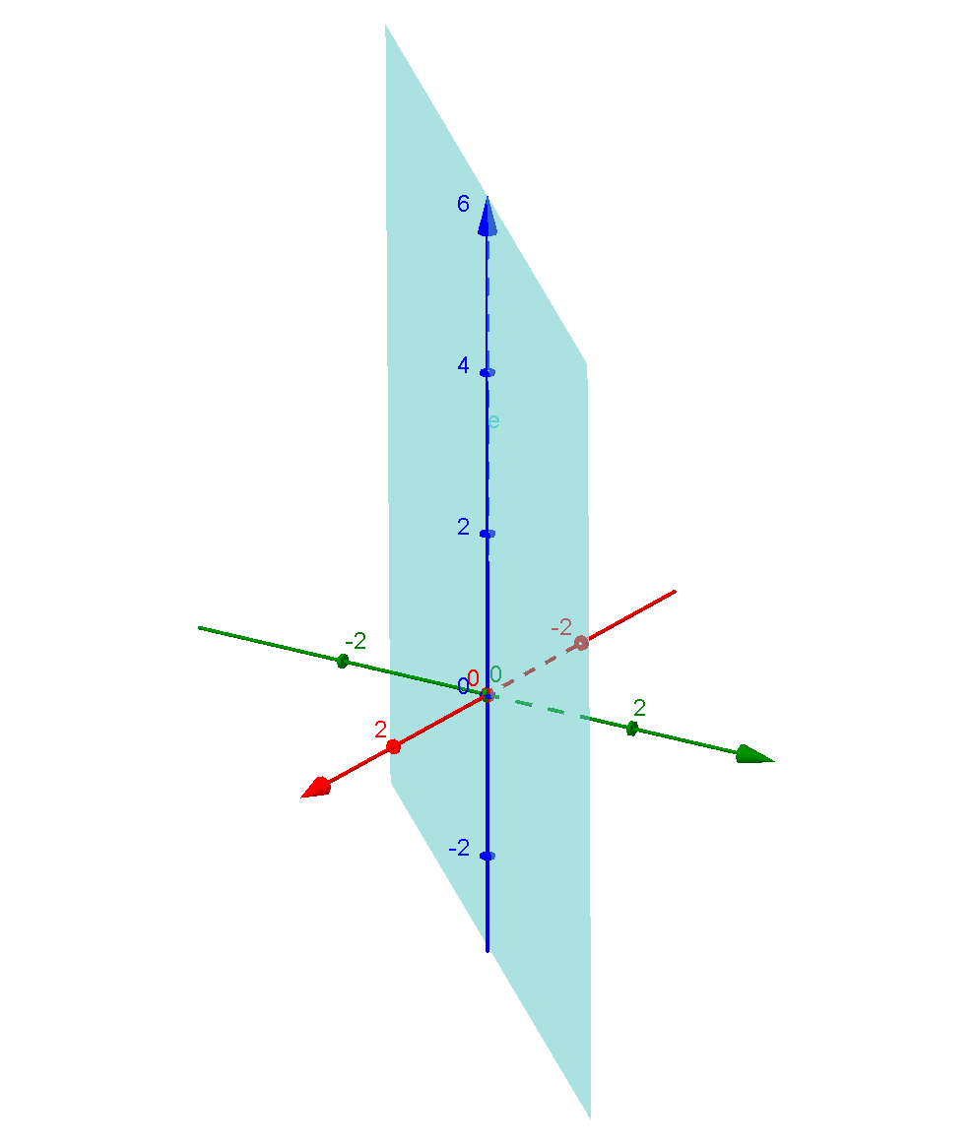
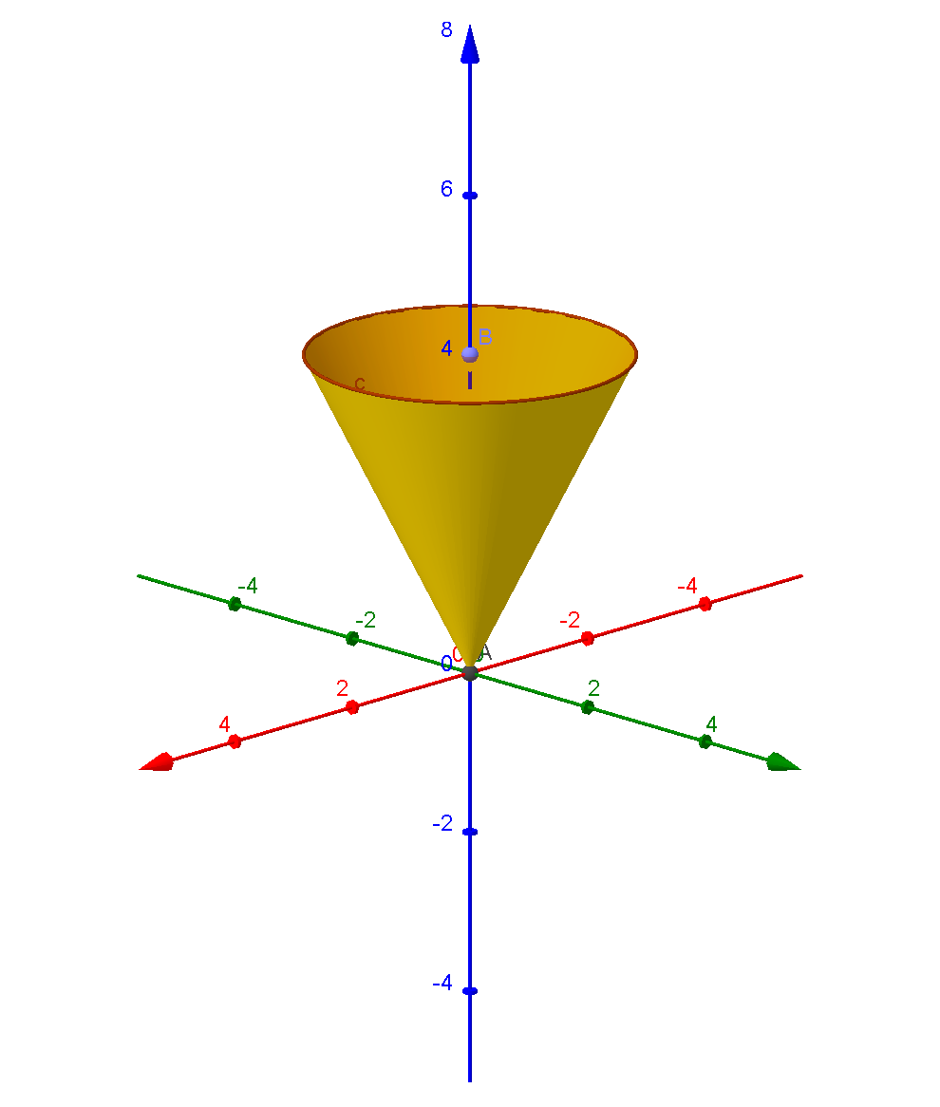
Spherical Coordinate Systems

Slide 19
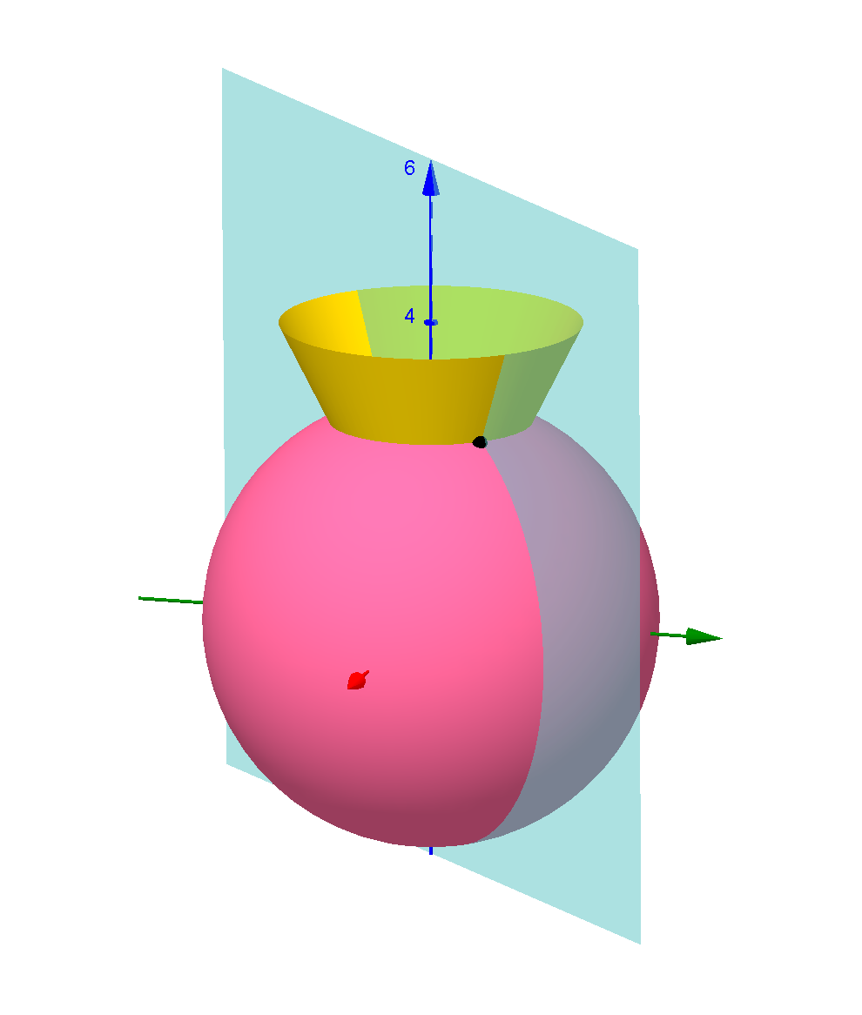
Spherical Coordinate Systems
Ɵ=Const
r sinƟ
(r, Ɵ, Φ)
r=Const
Ɵ
r
Φ
Φ=Const

Slide 20



Differential Elements in Spherical Coordinate Systems
z
dr
r sinƟ dΦ
Ɵ
dr
Ɵ + dƟ
r dƟ
r
y
r sinƟ dΦ
Φ
r sinƟ dΦ
Φ+dΦ
x
r dƟ

Slide 21








Relationship between Cartesian and Spherical Coordinate Systems
r sinƟ
z
r
y
r sinƟ
Φ
r sinƟ
Ɵ
x
z
P (x, y, z) = P (r, Ɵ, Φ)
z
r
Ɵ
z
y
x
r sinƟ
y
Φ
x
x
y

Slide 22
Electrostatics
Electrostatics is a branch of physics that deals with the phenomena and properties of stationary electric charges.
Electric charge has an effect in a region or a space around it. This region is called electric field of that charge.
Such an electric field produced due to stationary electric charge does not vary with time. It’s time invariant and called static electric field.

Slide 23
Coulomb’s Law
French Army Engineer, Colonel Charles Coulomb
He did experiments which are related to the force exerted between two point charges, which are placed near each other.
A point charge means that the electric charge which is spreaded on a surface or a space whose geometrical dimensions are very very small compared to the other dimensions. Thus point charge has a location but not the dimension.

Slide 24
Coulomb’s Law
A charge can be either Positive or Negative
A charge is actually the deficiency or excess electrons in the atoms of a particle.
A electron possesses a negative charge. So the deficiency of an electron produces a Positive Charge while excess of an electron produces a negative charge
The charge is measured in Coulombs (C)

Slide 25
Coulomb’s Law
Coulombs Law states that, force between two point charges Q₁ and Q₂
Acts along the line joining the two point charges
It is directly proportional to the product of the two charges (Q₁ and Q₂)
Is inversely proportional to the square of distance between them

Slide 26
Coulomb’s Law
Consider two point charges Q₁ and Q₂ separated by distance R
Q₁
Q₂
The charge Q₁ exerts force on Q₂ while Q₂ exerts force on Q₁
R
The force acts along line joining Q₁ and Q₂
The force exerted between them is repulsive if the charges are of same polarity, while it is attractive if charges are of different polarity.

Slide 27



Coulomb’s Law
The force F between two point charges can be expressed as
Coulombs law also states that this force depends on the medium in which the point charge is located. This effect is included as constant of proportionality.
Where
Permittivity of the medium in which charges are located.

Slide 28






Coulomb’s Law
In general is expressed as
Permittivity of free space or vacuum.
Relative permittivity (or) dielectric constant of the medium w.r.to free space
Absolute Permittivity.
For free space or vacuum
therefore
This is the force exerted between two point charges located in free space or vacuum.

Slide 29







Vector Form of Coulomb’s Law
The force exerted by Q₁ on Q₂ acts along the direction Where is the unit vector along . Hence the force in the vector form can be expressed as
F₁
Q₁
Q₂
Origin
Where
F₂
Similarly force F₁ is exerted on Q₁ due to Q_{2.} It can be expressed as
Where

Slide 30





Principle of Superposition
Consider a point charge Q surrounded by three point charges Q₁ ,Q₂ and Q₃
Q₁
Q₂
The total force on Q is the vector sum of all the forces exerted on Q due to each of the other point charges Q₁ ,Q₂ and Q₃
Q
Origin
Q₃
Force exerted on Q due to Q₁
Where

Slide 31







Principle of Superposition
Force exerted on Q due to Q₂
Where
Force exerted on Q due to Q₃
Where
Hence the total force on Q
In general for n charges

Slide 32
Electric Field Intensity
F₂
Consider a point charge Q₁ as shown
+
Q₂
If any other similar charge Q₂ is brought near to it, Q₂ experiences a force. In fact if Q₂ is moved around Q₁ , still Q₂ experiences a force as shown.
+
Q₁
Thus there is a region around a charge in which it exerts a force on any other charge. This region where a particular charge exerts a force on any other charge located in that region is called “ELECTRIC FIELD” of that charge

Slide 33


Electric Field Intensity
The force exerted by Q₁ on Q₂
The force per unit charge is given by
This force exerted by unit charge is called ELECTRIC FIELD INTENSITY or ELECTRIC STRENGTH. It is a vector quantity and is directed along a segment from the charge Q₁ to the position of any other charge. It is denoted by E.
Where P is the position of any other charge around Q₁
Its unit is Newton / Coulomb

Slide 34

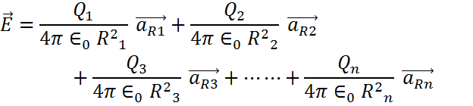







Electric Field Intensity due to discrete charges
Q₁
Q₂
R₁
R₂
R₃
P
Q₃
R₄
Q₄
Where
R_{n}
Q_{n}
r_{P} is the position of point P &
r_{i} is the position of point where Q_{i} is placed

Slide 35









Electric Field Intensity due to Infinite Line charges
z
Coordinates of dQ is (0, 0, z)
dQ (0, 0, z)
Coordinates of P is (0, r, 0)
Hence distance vector R can be written as
dl = dz
R
P
Ɵ
(0, r, 0)
r
y
x
d
d

Slide 36


Electric Field Intensity due to Infinite Line charges
Sub (1) , (2) and (3) in (4) we get
For every charge on positive Z axis there is equal charge present on negative z- axis. Hence the Z component of electric field intensities produced by such charges at point P will cancel each other. Hence effectively there will not be any Z component of at P.
Hence (5) can be written by eliminating
By integrating (6) over Z axis from to we get total at point P.

Slide 37



















Electric Field Intensity due to Infinite Line charges
Integration by trigonometric substitution
Using Integration by substitution
Substitute
- - - - (8)
Substitute
Changing limits from Z to Ɵ
For
Substitute
- - - - (9)
Substitute

Slide 38
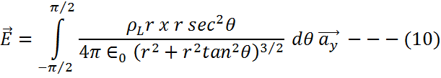
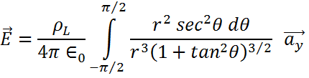
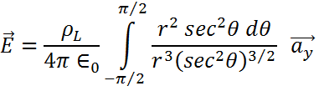
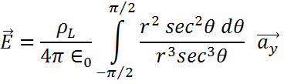
Electric Field Intensity due to Infinite Line charges
Sub (8) and (9) in (7) we get

Slide 39
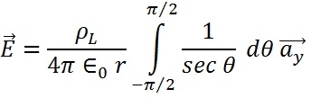






Electric Field Intensity due to Infinite Line charges
We know that

Slide 40
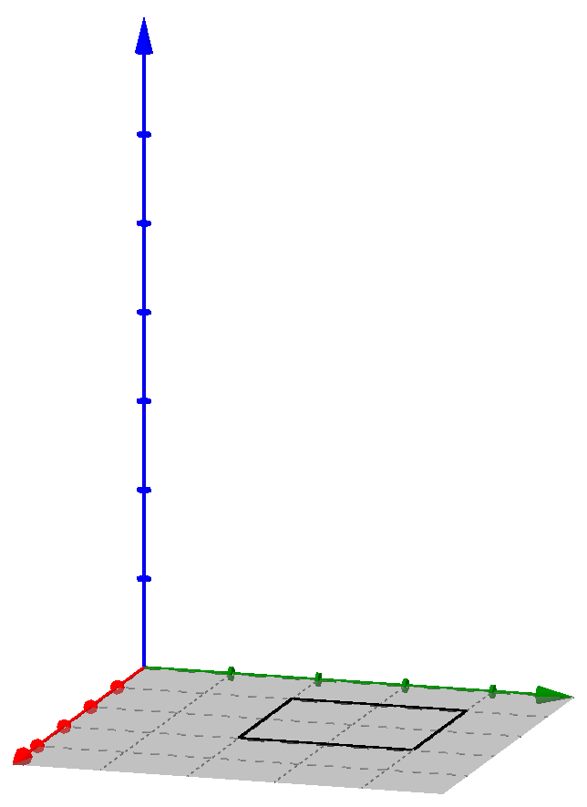



Electric Field Intensity due to Infinite sheet of charge
Z
Consider an infinite sheet of charge having uniform charge density of placed in XY plane as shown. Let us use cylindrical co-ordinates. The point P at which
P
is to be calculated is on z-axis. Consider the differential surface dS carrying a charge dQ. The normal to dS is in Z direction hence dS normal to Z direction is
Now
dS
Hence
O
Y
X
r
dQ

Slide 41






Electric Field Intensity due to Infinite sheet of charge
Z
The distance vector has two components as shown
1. The radial component r along i.e.
P
2. The component Z along i.e.
With these two components can be obtained from the differential area towards point P as,
dS
O
Y
X
r
dQ

Slide 42

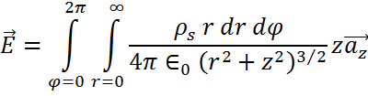
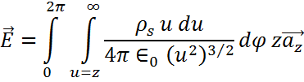
Electric Field Intensity due to Infinite sheet of charge
Substituting (3), (4) and (5) in (2) we get
In cylindrical co-ordinate systems r varies from 0 to INFINITY while Φ varies from 0 to 2PI
Put Z² +R² =U² Hence 2rdr = 2UdU
For r = 0, u=Z and r= , U=

Slide 43
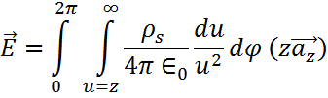
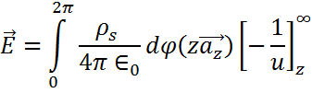



Electric Field Intensity due to Infinite sheet of charge
(V/m) For points above XY plane
(V/m) For points below XY plane

Slide 44
Thank You

